Slide 1

INSTITUTE :UIE
DEPARTMENT: ALL ACADEMIC UNITS
Bachelor of Engineering (All Sections)
Subject Name and Code:
Engineering Physics 23SPH-141
Prepared by: Ms. Arminder
UNIT 3
QUANTUM MECHANICS
DISCOVER . LEARN . EMPOWER

Slide 2
COURSE OBJECTIVES
The course is designed to make the students industry ready to contribute in the growing demand of the industry at local, national and international level.
It will make the students competent to understand basic concepts and applications of advanced engineering physics and apply its principles in their respective fields at global platform.
It will enhance the skill level of the students and shall make them preferred choice for getting employment in industry and research labs.
It will give thorough knowledge of the discipline to enable students to disseminate knowledge in pursuing excellence in academic areas.

Slide 3

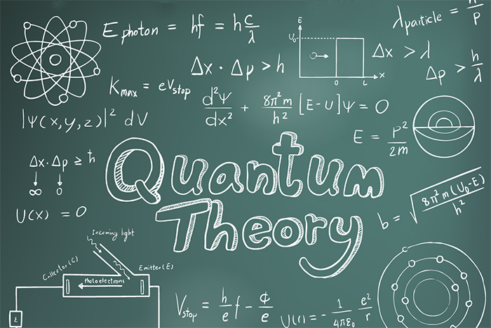
COURSE OUTCOME
CO Number | Title On completion of this course, the students are expected to learn | Level
CO1 | Quote the basic fundamental concepts of lasers, optical fibres, crystallography, ultrasonic oscillations, semiconductor physics, quantum mechanics and nanotechnology. | Remember, Understand
CO2 | Demonstrate the working of various lasers, fibre components, semiconductor devices; explain the behaviour of crystalline solids, quantum and nano-scale systems. | Understand
CO3 | Solve problems by applying principles related to lasers, fibres, semiconductors, oscillations, quantum and nanoscience. | Applying
CO4 | Compare various lasers and fibres, semiconducting devices, crystalline materials, structures at quantum and nanoscale on the basis of their properties for industrial applications. | Analyze
CO5 | Develop various systems using lasers, fibres, semiconductors and nanomaterials for futuristic applications. | Design
Figure 1 Quantum Theory [1]

Slide 4
INTRODUCTION
UNIT -3
QUANTUM MECHANICS
TIME DEPENDENT SCHRODINGER EQUATION

Slide 5
CONTENT
Introduction
Benefits
History
Applications

Slide 6
LECTURE OBJECTIVE
1
Students will learn about wave function.
2
Students will learn about different quantum variables.
3
Derive time dependent equation.

Slide 7
CONTENT
Photon-momentum
Schrodinger’s cat
Introduction
Time-dependent Schrodinger’s equation

Slide 8
PHOTON MOMENTUM
IN FREE SPACE:
IN OPTICAL MATERIALS:

Slide 9
SCHRODINGER EQUATION-INTRODUCTION
Schrödinger Equation is a mathematical expression which describes the change of a physical quantity over time in which the quantum effects like wave-particle duality are significant. The Schrödinger Equation has two forms the time-dependent Schrödinger Equation and the time-independent Schrödinger Equation.

Slide 10
TIME DEPENDENT SCHRODINGER EQUATION
It was observed that the wave function of a particle of fixed energy E could most naturally be written as a linear combination of wave functions of the form
Ψ(x,t) = Ae^{i(kx−ωt)}
representing a wave travelling in the positive x direction, and a corresponding wave travelling in the opposite direction, so giving rise to a standing wave.
for a free particle of momentum p = ℏk and energy E = ℏω. With this in mind, we can then note that
∂²Ψ /∂x² = −k²Ψ

Slide 11
TIME DEPENDENT SCHRODINGER EQUATION
which can be written, using E = p²/2m = ℏ²k²/2m
-ℏ² /2m ∂²Ψ /∂x² = p²/ 2m Ψ………. (1)
Similarly, ∂Ψ/ ∂t = −iωΨ
which can be written, using E = ℏω
iℏ ∂Ψ/ ∂t = = EΨ………..(2)

Slide 12
TIME DEPENDENT SCHRODINGER EQUATION
We now generalize this to the situation in which there is both a kinetic energy and a potential energy present, then
E = p²/2m + V (x)
so that EΨ = p²/ 2m Ψ + V (x)Ψ

Slide 13
TIME DEPENDENT SCHRODINGER EQUATION
where Ψ is now the wave function of a particle moving in the presence of a potential V (x). But if we assume that the results and still apply in this case then we have
− ℏ²/ 2m ∂²ψ/ ∂x² + V (x)Ψ = iℏ ∂ψ/ ∂t
TIME-DEPENDENT SCHRODINGER EQUATION

Slide 14
SUMMARY
Wave function can be written as
Ψ(x,t) = Ae^{i(kx−ωt)}
Time dependent wave equation is
-ℏ²/ 2m ∂²ψ/ ∂x² + V (x)Ψ = iℏ ∂ψ/ ∂t

Slide 15
FREQUENTLY ASKED QUESTIONS
Give energy and momentum operator.
Derive time independent energy operator.

Slide 16
REFERENCE-BOOKS
Concepts of Modern Physics, (Fifth Edition) A Beiser, McGraw Hill International.
T2. Fundamentals of Physics, David Halliday, Robert Resnick and Jearl Walker, Wileyplus.

Slide 17
REFERENCE -VIDEOS
https://www.youtube.com/watch?v=QeUMFo8sODk
https://www.youtube.com/watch?v=Iy6RspNw80E

Slide 18
REFERENCE-WEBSITE
http://physics.mq.edu.au/~jcresser/Phys201/LectureNotes/SchrodingerEqn.pdf
http://vergil.chemistry.gatech.edu/notes/quantrev/node9.html
https://www.britannica.com/science/quantum-mechanics-physics/Time-dependent-Schrodinger-equation

Slide 19
THANK YOU
For queries
Email: arminder.uis@cumail.in

